Slide 1
Restaurant review summarization and recommendation using Ne04j

Slide 2
Introduction
A user has to go through a lot of useless details on numerous reviews before he could get a clear understanding of a particular restaurant.
Deciding a restaurant to go to, can become a lot easier if there exists a summary of all the reviews of that restaurant.
This summary could be a list of small phrases, such as, “great food”, “loud music”.
Faster decision making, and clearer understanding, because a summary would be derived from a collection of reviews.

Slide 3
Problem Statement
Categorize each sentence in the reviews of a restaurant into 4 main categories,
Food
Ambience
Price
Service
Summarize reviews on these categories individually to give the user an understanding about the restaurant without going through the entire set of reviews.
Present similar restaurants from the database to the user.

Slide 4
Data Model – Ne04j
The sentences in each review are classified into Food, Price, Ambience, and Service.
Each “Review” node consists of one sentence and there can be 4 types (R_F, R_P, R_A, and R_S) of relationships between Restaurant node and Review node.
id
id
Review
R_F
R_P
Review
User
Rated
Restaurant
r.Count =ratings
R_A
Review
R_S
name
Review

Slide 5
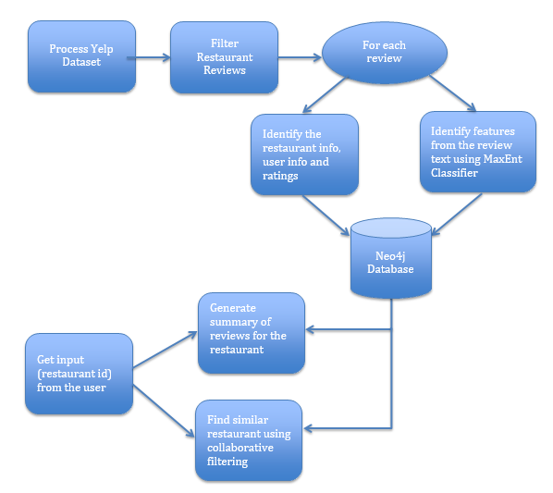
System Architecture

Slide 6
Data Processing
The yelp database has the following:
business.json – containing business_id, category_of_business and so on.
review.json – containing userid, review, ratings, id of business.
We filter out restaurantids from business.json by looking at the category.
Using these restaurant_ids we filtered out the restaurant_reviews from the review.json.
We used spark to do this filtering, to achieve data parallelization for yelp dataset processing.

Slide 7
Data Processing
Our goal is to get categorized summary, that is, individual summaries for different characteristics of the restaurant.
The review is tokenized into sentences.
Each sentence is classified into one of Food, Service, Ambience, Price, and Misc categories.
Misc category sentences are ignored.
These sentences are then added to the graph based on its category.
Each sentence represents a node and there are 4 main relationships possible as we saw before.
Therefore, if there are 20 sentences in the review of a restaurant, there would be 20 nodes, each representing one sentence.

Slide 8
Review Summarization
The review summarization was done using Neo4j which is a graph database.
Given a restaurant id, we go through all reviews of that particular restaurant and build the graph as follows.
Each word of the sentence is represented by a shared node in the graph
Order of words reflected by relationships pointing to the next word.
Hypotheses :
Most significant sentences, positive or negative, are repeated across different reviews.
When a new word occurs, a node is created and the relationship between the previous word and this new word is made to 1. (first occurrence)
Else, the count is just incremented.

Slide 9
Review Summarization contd.
Adding a sentence to the graph:
WITH split(<sentence>," ") as words
UNWIND range(0,size(words)-2) as idx
MERGE (w1:Word {name:words[idx]})
MERGE (w2:Word {name:words[idx+1]})
MERGE (w1)-[r:NEXT]->(w2)
ON CREATE SET r.count = 1 ON MATCH SET r.count = r.count +1;

Slide 10
Review Summarization contd.
Finding the most important phrase:
MATCH path = (w:Word)-[:NEXT*..5]->()
WHERE ALL (r IN rels(path) WHERE r.count > 1)
RETURN [w IN nodes(path)| w.name] AS phrase, reduce(sum=0,r IN rels(path)| sum + r.count) as score
ORDER BY score DESC
LIMIT 1

Slide 11
Collaborative filtering
Final step of our project is done using collaborative filtering.
In order to give recommendation, we need to find similar restaurants to the current restaurant.
Given a particular restaurant, we trying to find similar restaurants which we can give as a recommendation.
Similarity can be found using different measures, like cosine, Pearson correlation etc.
Here we made use of Pearson coefficient.

Slide 12

Collaborative filtering contd.
In above equation, it tries to find how similar x and y is and its values ranges from -1 to 1 inclusive. -1 indicates least similar and 1 indicates most similar(perfect match).

Slide 13
Dataset used
Used a huge yelp dataset.
1.4 gigabytes of reviews.( Contains around 2 lakh restaurant reviews)

Slide 14
Tech Stack
Technologies used:
Java – Version 1.7.0_75
Spark – Version 2.1
Neo4j – Version 2.2.1

Slide 15
Libraries used
Stanford postagger – Used for adding rules to find significant phrases.
Spark-core-2.1 – (Spark) Used to filter out restaurant reviews from the huge yelp database.
Neo4j-lib – Graph database for finding out significant phrases.
OpenNLP-tools – NLP tools for data classification using Max Entropy model.

Slide 16
Contributions
NLP and Collaborative filtering
Arvind Krishna Parthasarathy and Jemishkumar Sureshchandra Patel
Data modeling and Neo4j application development
AnukulKumar Thandra and Kumaran Rajendiran
Spark- Data Processing
Purusoth Mahendran and Santhosh Vivekanandan

Slide 17
Conclusion
Our implementation extracts the most important and significant facts about a restaurant’s different characteristics.
Saves a lot of time for the user, as he can now just quickly look through the summary and make his decision.
Furthermore, we provide recommendations to the user by finding similar restaurants to the current restaurant.

Slide 18
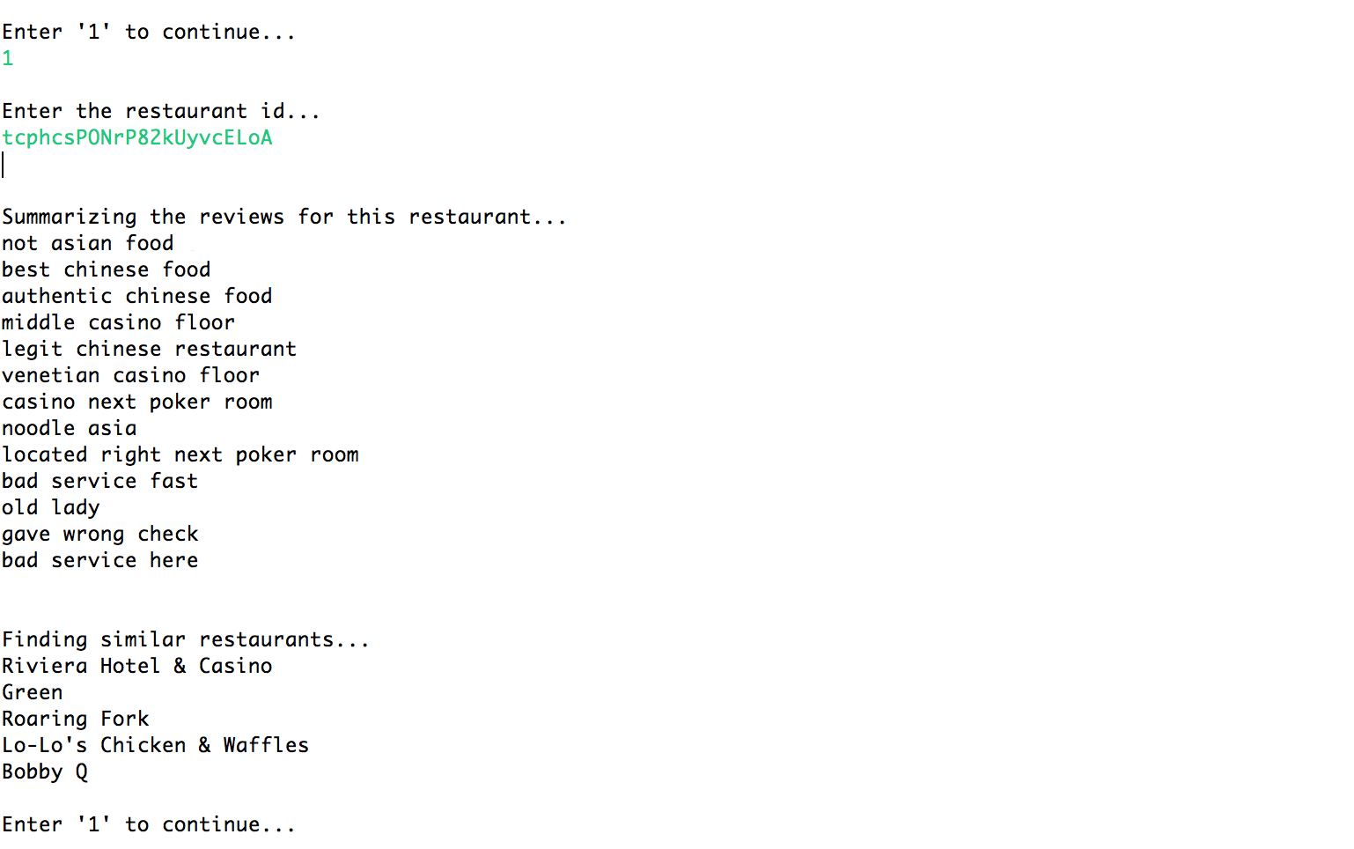
Screenshot

Slide 19
References
Natural Language Analytics made simple and visual with Neo4jhttp://neo4j.com/blog/natural-language-analytics-made-simple-visual-neo4j
Cypher Query Language http://neo4j.com/docs/stable/cypher-query-lang.html
Stanford Log-linear Part-Of-Speech Tagger http://nlp.stanford.edu/software/tagger.shtml
Apache OpenNLP Developer Documentationhttps://opennlp.apache.org/documentation/1.5.2-incubating/manual/opennlp.html
Bo Pang and Lillian Lee, A Sentimental Education: Sentiment Analysis Using Subjectivity Summarization Based on Minimum Cuts
Manoj Pawar, Deepak Mallya : Automated Summarization of Restaurant Reviews

Slide 20
Thank you!

